Slide 1

Housing Partnerships
September 13, 2024
Mural by Tia Richardson

Slide 2





Stable housing can …
Improve dropout rates by 30%
Reduce crime by 20%
Increase employment rates by 20%
Improve health by 18%
for additional information & updates visit www.housingPlan.org

Slide 3
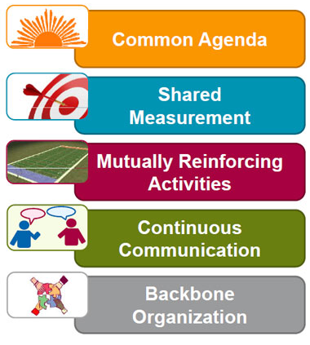

Collective Impact achieved population level change when it focused on data, resources, policies, and systems
Most mature implementation started with backbone support and common agenda

Slide 4
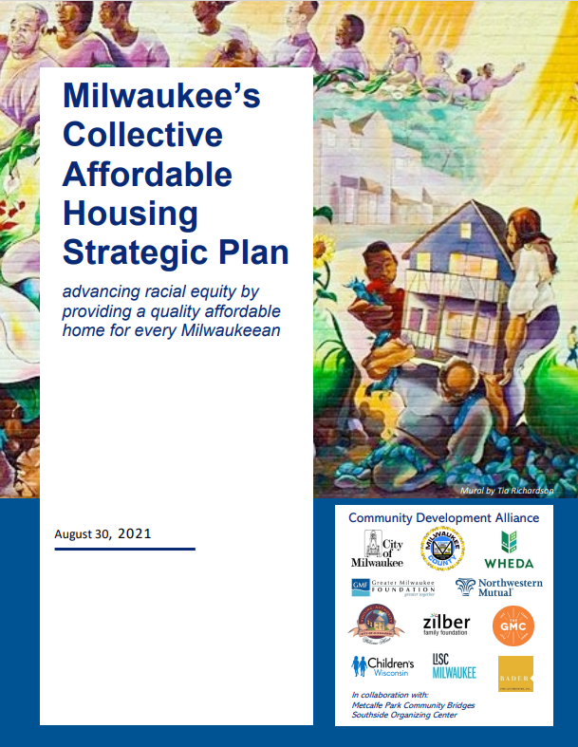
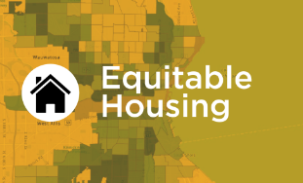
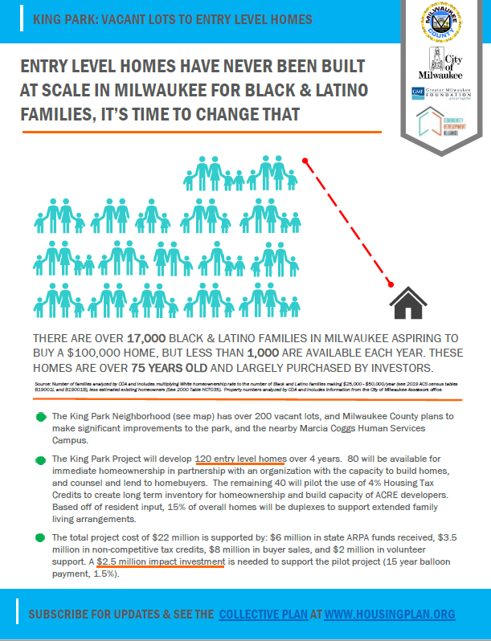
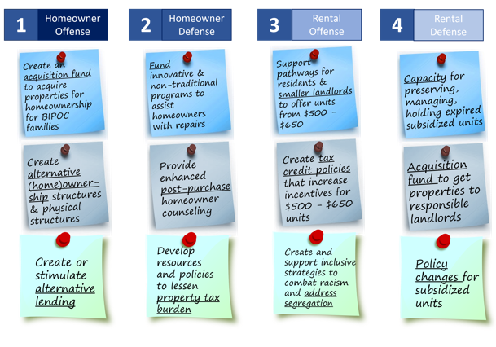


Slide 5
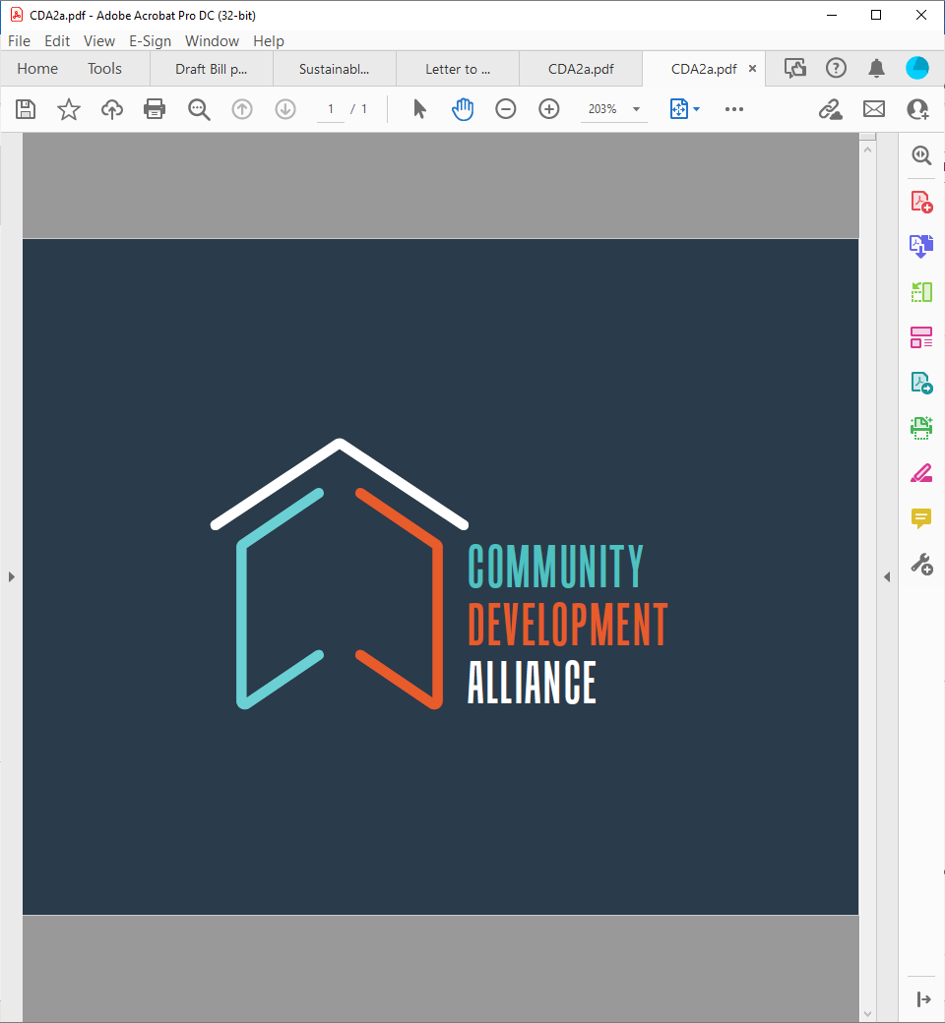





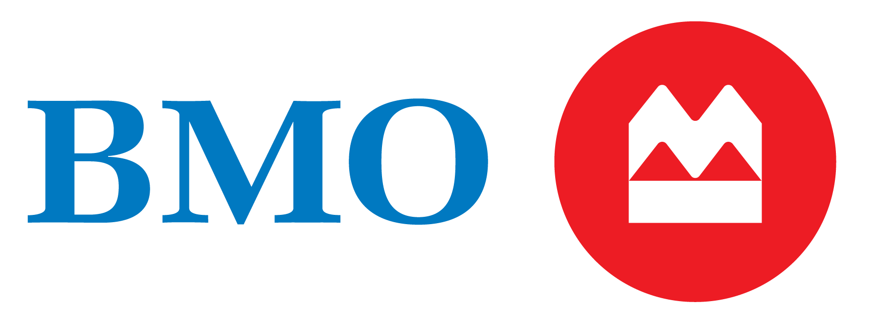










advancing racial equity by providing a quality affordable home for every Milwaukeean
Christine Symchych
& Jim McNulty

Slide 6


















advancing racial equity by providing a quality affordable home for every Milwaukeean
Homebuyer Counseling Partners
Vacant Lots to Entry Level Homes Partners
Collaboration Partners

Slide 7
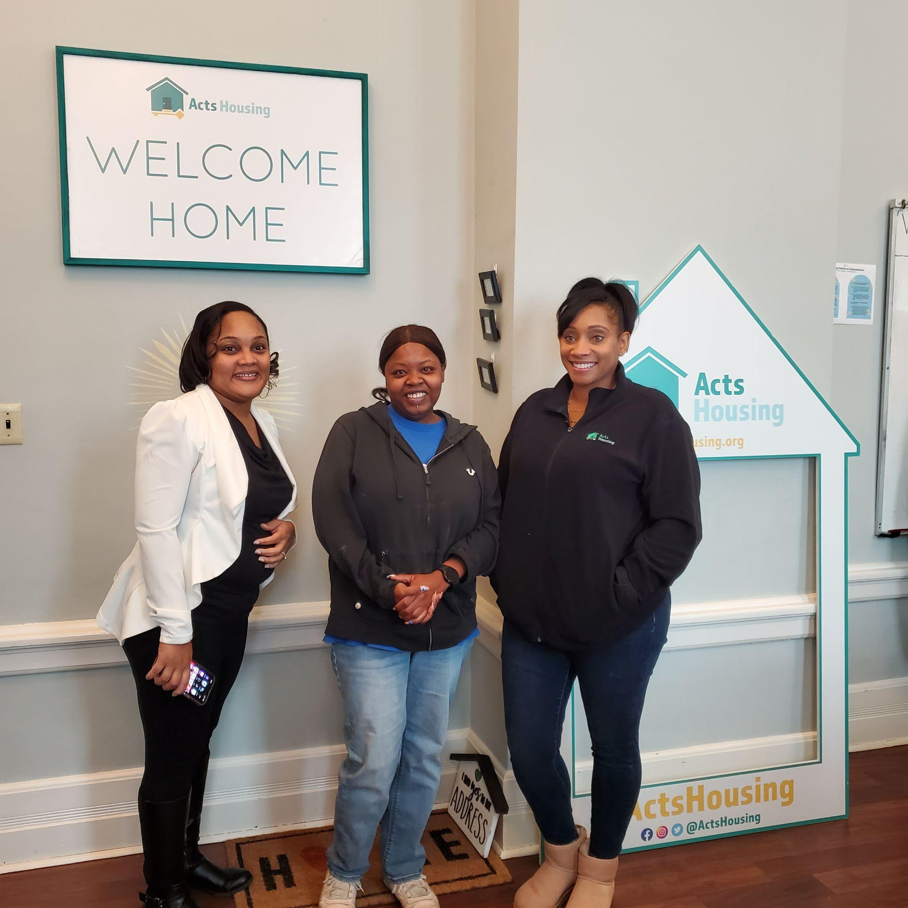

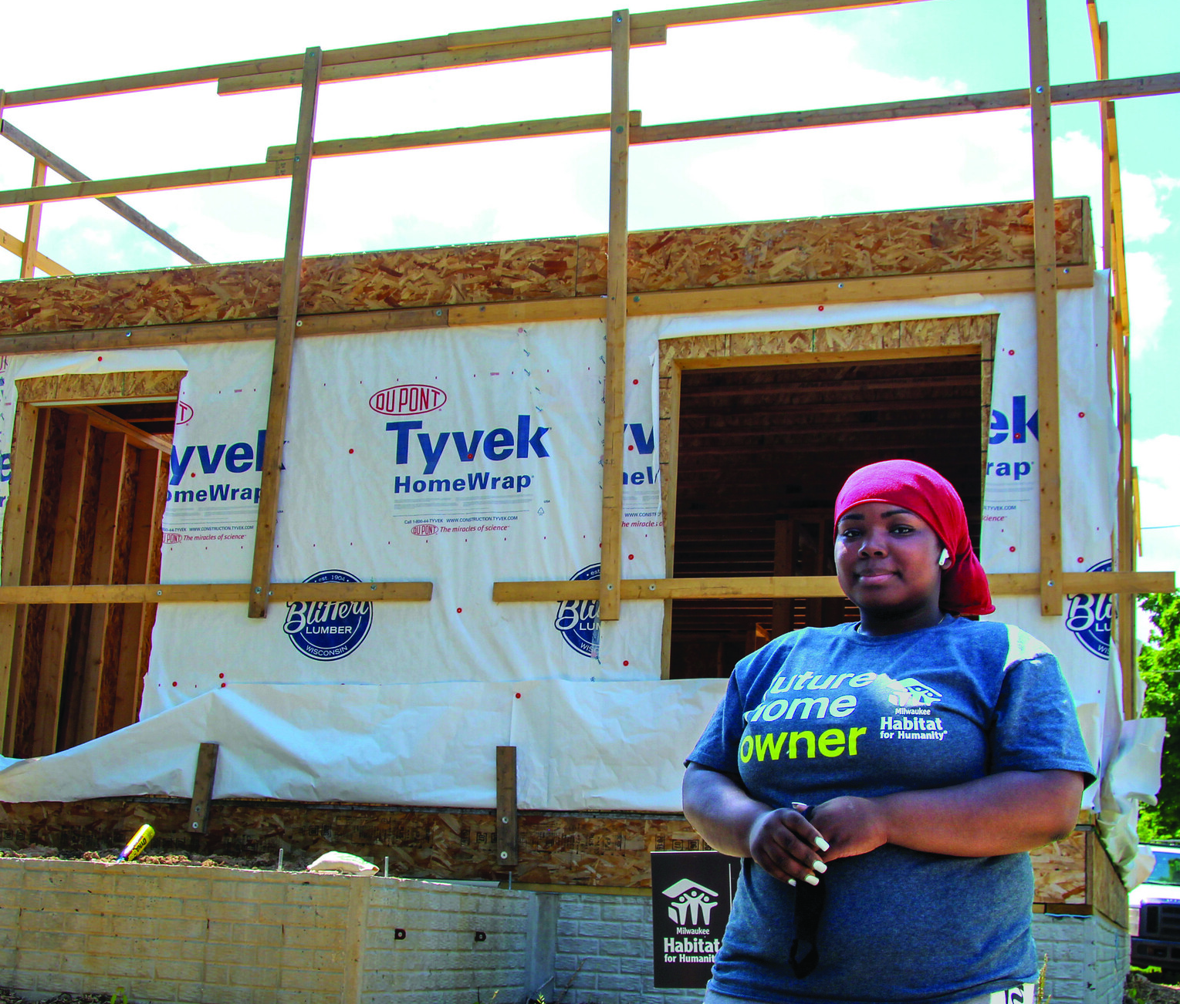
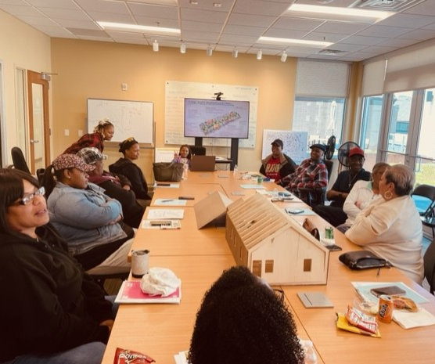
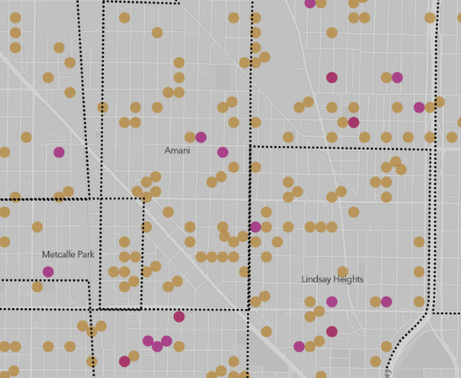
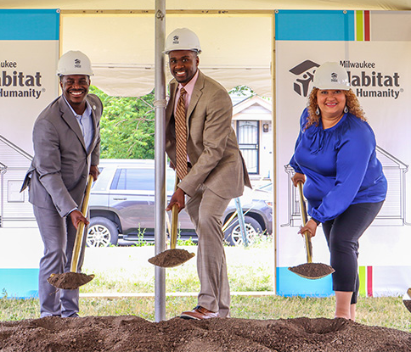
Built Nation’s First Homeowner Acquisition Fund
Impact:
40 homes in Production
40 homes Acquired
600 Homeowners
Customer:
Net Promoter Score
Meeting Attendance
Contributing Members
Internal
Process Improvements
Finances
Learning
Community Collaboration
Employee Turnover Rate
Conferences Presented
We build systems, communities & homes
2023 Highlights
Doubled Production of Entry Level Homes.
166 Homes in pipeline.
Built Comprehensive Resident Collaboration System
Built Collective Homeownership Data System
Invested $26 Million since 2022
Doubled Production of New Construction Entry Level Homes
Built Comprehensive Resident Collaboration System
Built Collective Program Level Homeownership Data System
Total raised since 2022 - $26 Million

Slide 8
advancing racial equity by providing a quality affordable home for every Milwaukeean

Slide 9

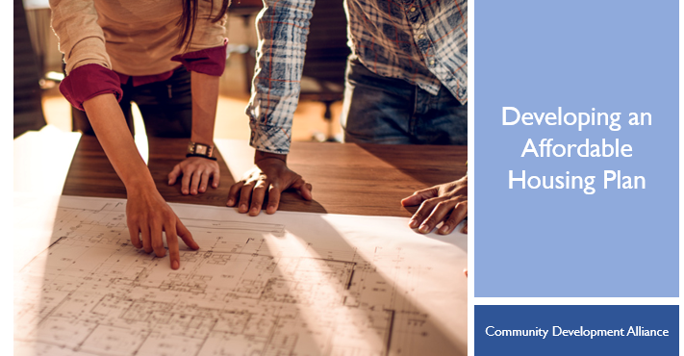
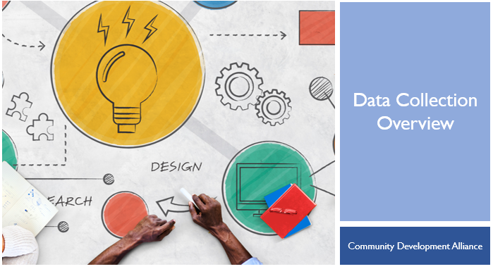
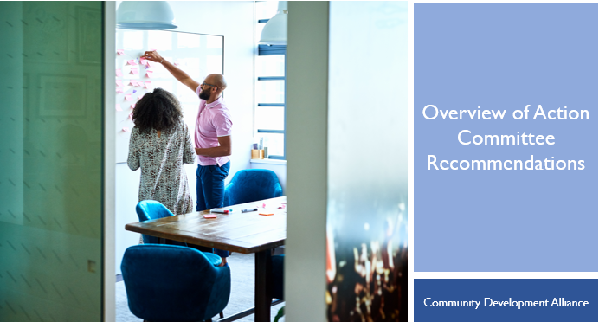
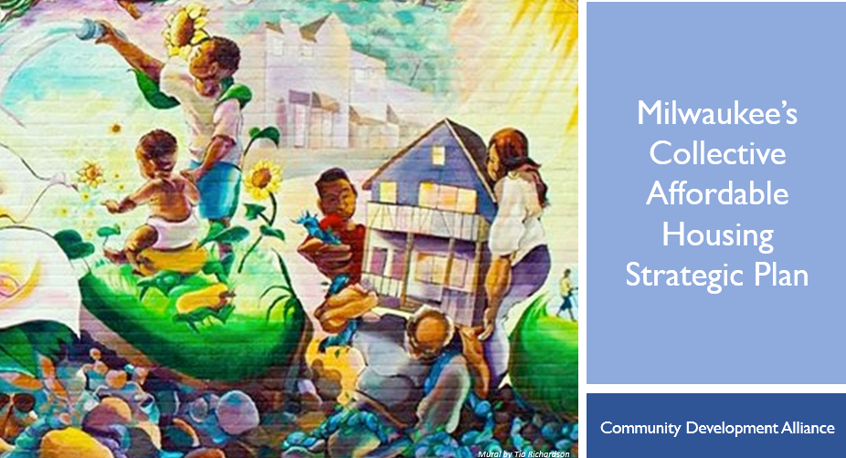
GARE Racial Equity Policy Process
Vision
SEE IT
GET READY
DO IT
Data
1. Set Racial Equity Vision
Engage
2. Collect & Analyze Data
3. Engage Allies
4. Develop Equitable Strategy
Strategy
Imple-
ment
Detailed Plans
You are
here!
5. Implement Changes
6. Monitor & Communicate Progress for Accountability
7. Update & Continuously Improve
Account-
ability
Monitor & Communicate
Update
Continuous Improvement

Slide 10
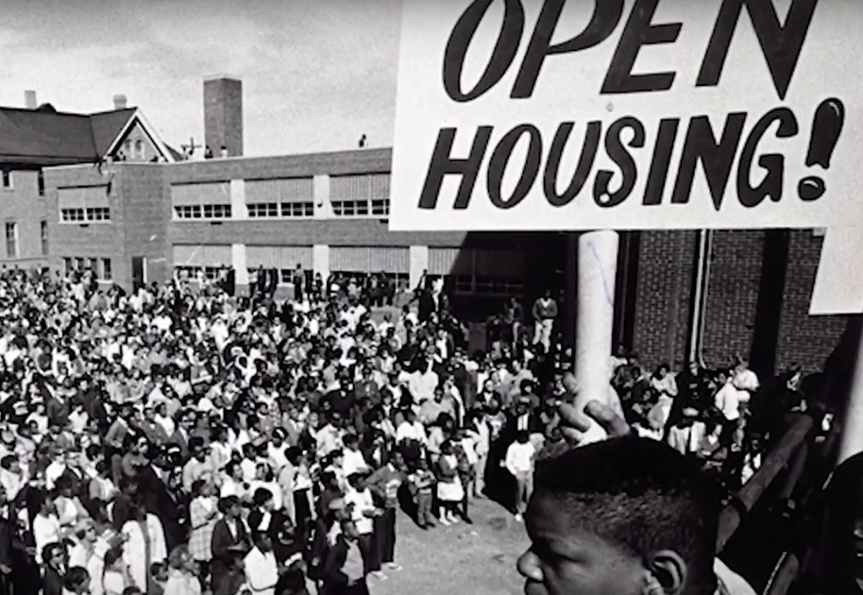

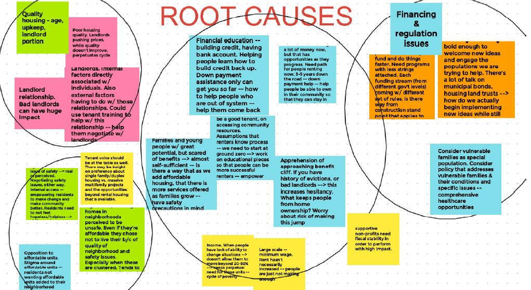

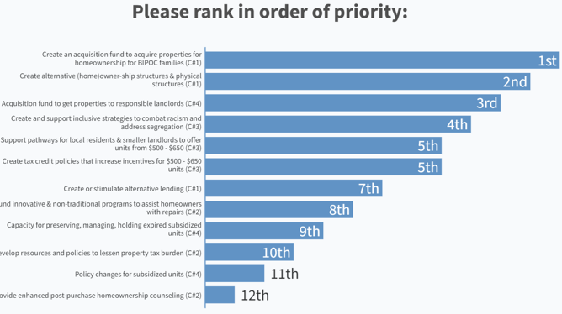

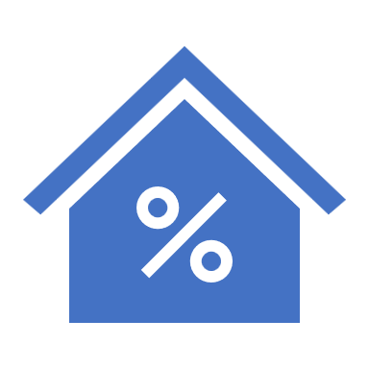
Collective Objectives
Grow homebuyer counseling & down payment assistance (DPA)
Acquisition Fund to combat predatory acquisition
Vacant Lots to 1st Generation Homes
Alternative lending based on rental history and 40 – 60% DTI

Slide 11
Collective Affordable Housing Plan: 2024 Q2 Update
 | Grow DPA | Acquisition Fund | Entry Level Homes | Alternative Lending
Long Term Goal | Grow Down Payment Assistance (DPA) & Homebuyer Counseling by 10% each year for 5 years | Acquire 100 single family homes and duplexes every year that would otherwise be investor owned and sell to homeowners | Construct 100 entry level homes on vacant lots every year | Create a local lending pool that lends to first time homebuyers based on rental history
Q1 OKR Update | Complete Agreements with HBC organizations | LIHTC Expiration ASAP Session | Backbone TID approved by City Staff | Conversations with Investors.
Recommended Q2 OKR | Integrate quarterly neighborhood organization meeting Distribute funds to HBC Launch Section 8 to Homeowner Team | Launch LIHTC expiration team | Complete 25 Foot wide lot design Submit Harambee TID Information to City Begin Planning Lindsay Heights TID CDA Board support of Grow MKE | Pitch plan to investor challenge

Slide 12




What is affordable housing?
affordable housing is when a home is available for 30% of a FAMILY’S income
for families like early childhood EDUCATORS that’s $650/month
with good policy a quality affordable home is available for everyone
for additional information & updates visit www.housingPlan.org

Slide 13


What is affordable housing?
Early Childhood Educator, Healthcare Aide, Warehouse Worker
Teacher, Firefighter, Postal Carrier
Architect, Professor
An educator making $12 an hour can afford a rental home for $650/Month, or a $45,000 home.
A Teacher making $24 an hour can afford a rental home for $1,250/Month, or a $100,000 home.
A Professor making $40 an hour can afford a rental home for $2,500/Month, or a $240,000 home.
for additional information & updates visit www.housingPlan.org

Slide 14
Number of black & Latino Families
Not Currently Homeowners
Milwaukee County, Wisconsin
4,000
$40 - $50/Hour
11,000
$12 - $24/Hour
26,000
$24 - $41/hour

Slide 15
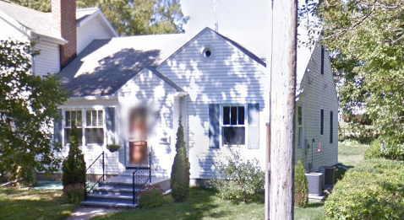
1968 Fair Housing Act

Slide 16
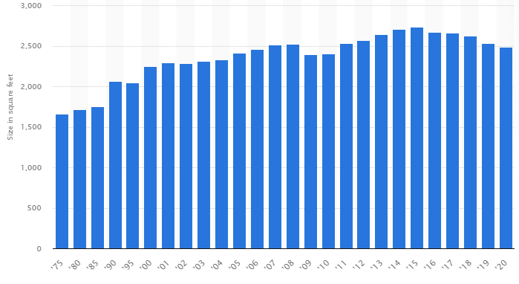
Average size of New Single-Family Homes
United states
• Size of new single-family homes in the U.S. | Statista

Slide 17
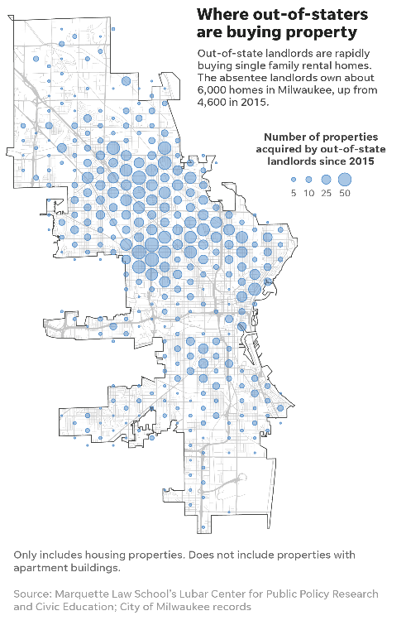
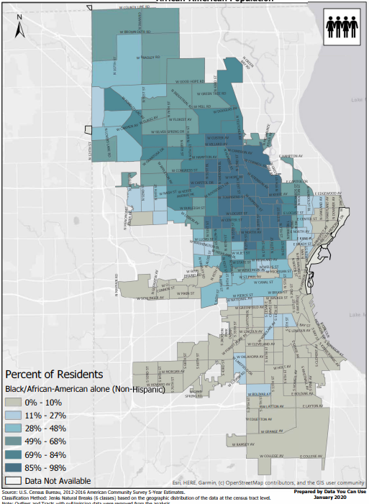
% drop in Homeownershp since 2010
- 2%
majority White neighborhoods
majority latino neighborhoods
majority black neighborhoods
- 15%
- 20%
2010
2015
2019
Source: Comparison of Milwaukee County ACS Census Tables P2 (Race, 2010) and B2118 (Homeownership)

Slide 18
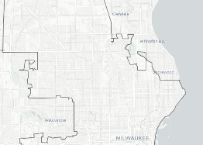

Slide 19
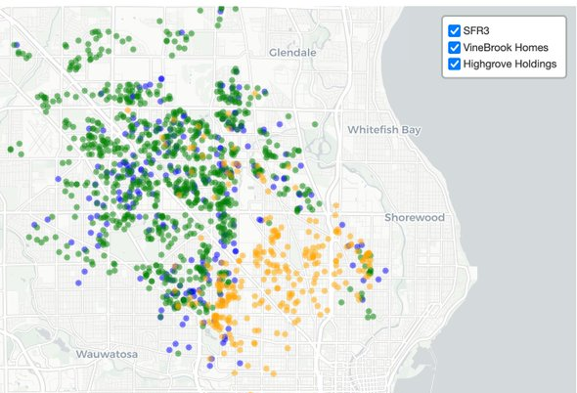
This out-of-state investment trend is largely driven by 3 private equity backed firms, all of which mainly target Milwaukee's north side. They collectively own over 1,400 houses, up from 17 five years ago.
John Johnson
Marquette Law School
Garden
Homes
Havenwoods
Sherman
Park
Sherman Park
(East)
Metcalfe Park
Amani
Lindsay
Heights
Harambee
Washington Park

Slide 20



40% of Milwaukee’s Entry Level home inventory has been purchased by Investors
There are over 17,000 black & Latino families in Milwaukee Aspiring to buy a $125,000 home, but only about 1,500 are available each year, and over 40% have been purchased by investors
Source: Number of families analyzed by CDA and includes multiplying White homeownership rate to the number of Black and Latino families making $25,000 - $50,000/year (see 2019 ACS census tables B19001L and B19001B), less estimated existing homeowners (See 2000 Table HCT035). Property numbers analyzed by CDA and includes information from the City of Milwaukee Assessors office.

Slide 21
In one year there were 2,000 aspiring black & Latino Homeowners in Milwaukee that completed homebuyer Coaching
INVENTORY
but only about 600 have received Inventory & loans
CREDIT

Slide 22
INVENTORY
CREDIT

Slide 23
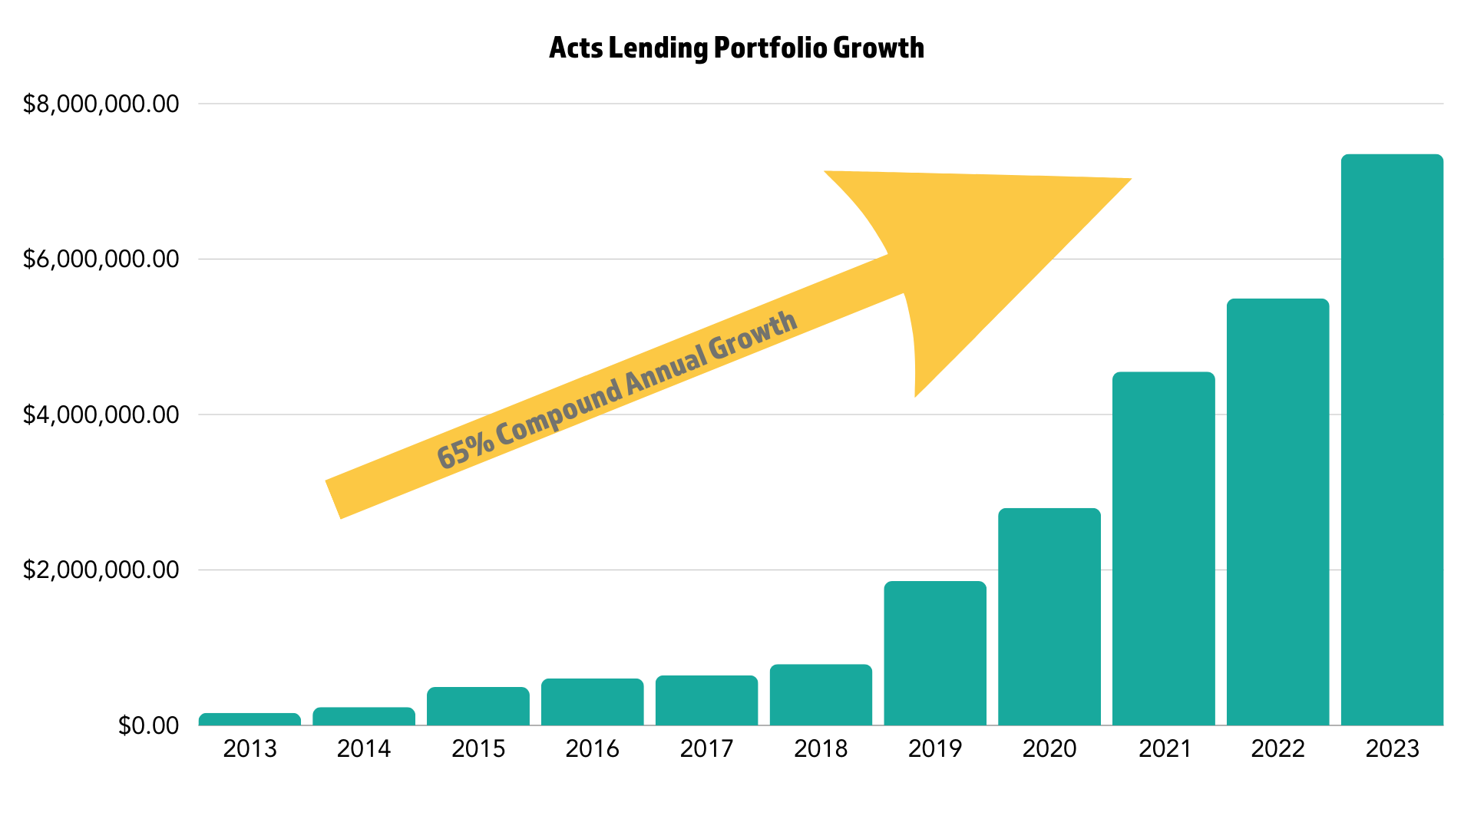
Acts Lending 10-year Pilot Results (2013-2023)
As of 3/31/24:
150 loans totaling $8 million
Notes:
Kelly:

Slide 24
Timeline
2024
2025
2026
2027
2028
Pilot in Q4
75 new loans $11.2MM
100 new loans $15.4MM
150 new loans $23.6MM
(and beyond) 200+ loans $32.0MM
Notes:
Mike:

Slide 25

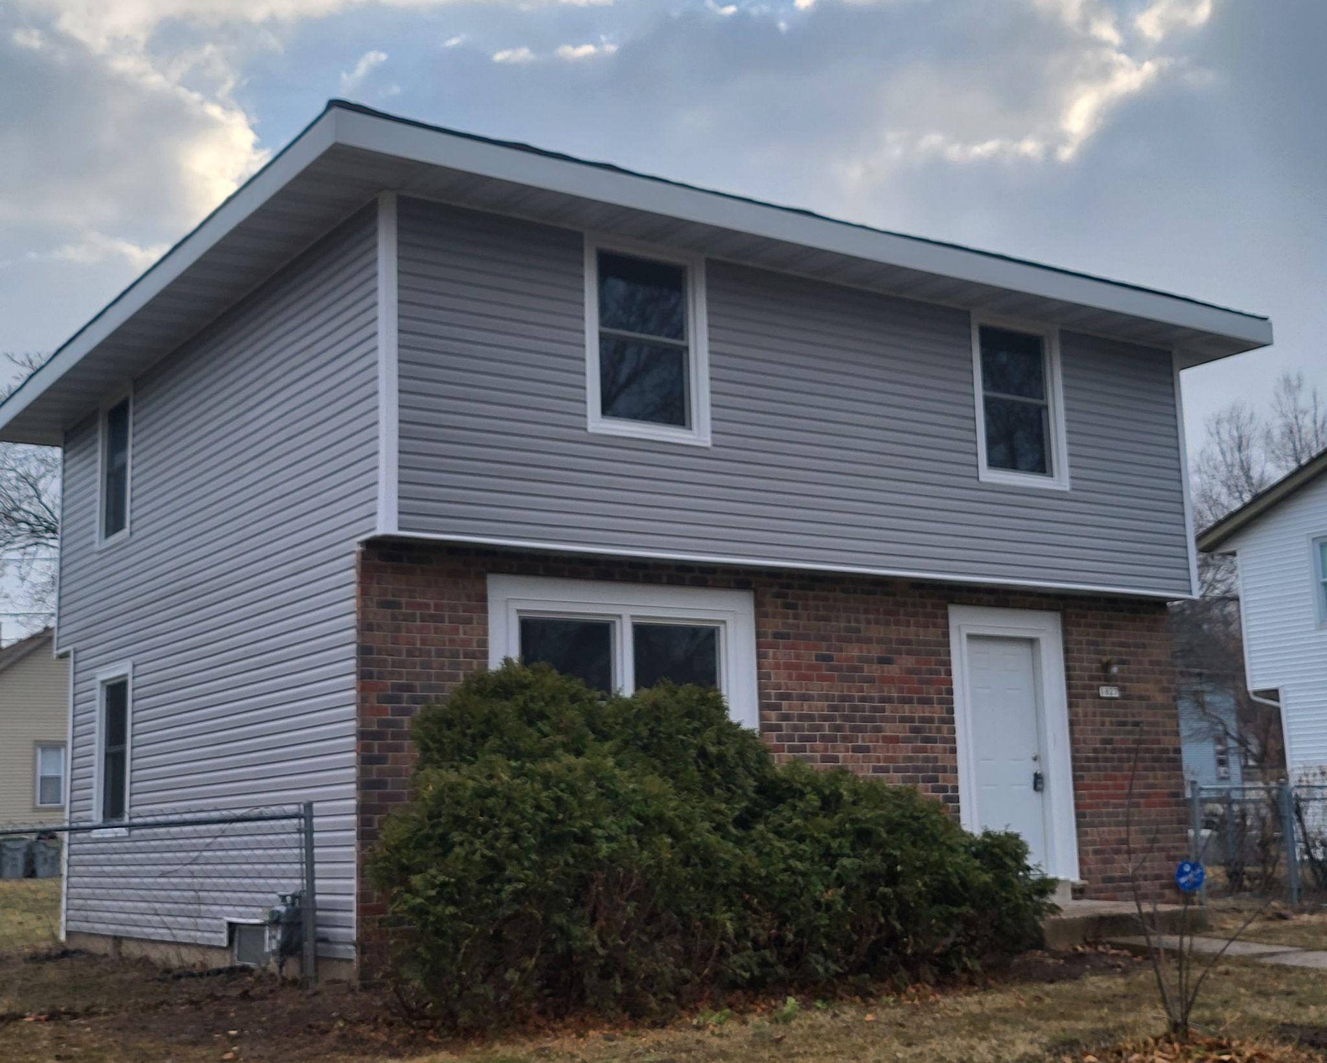
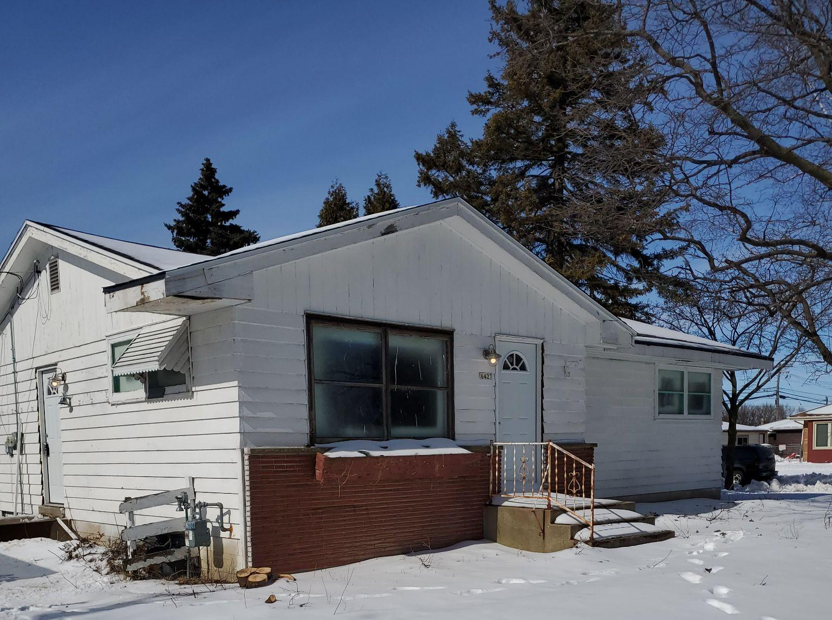
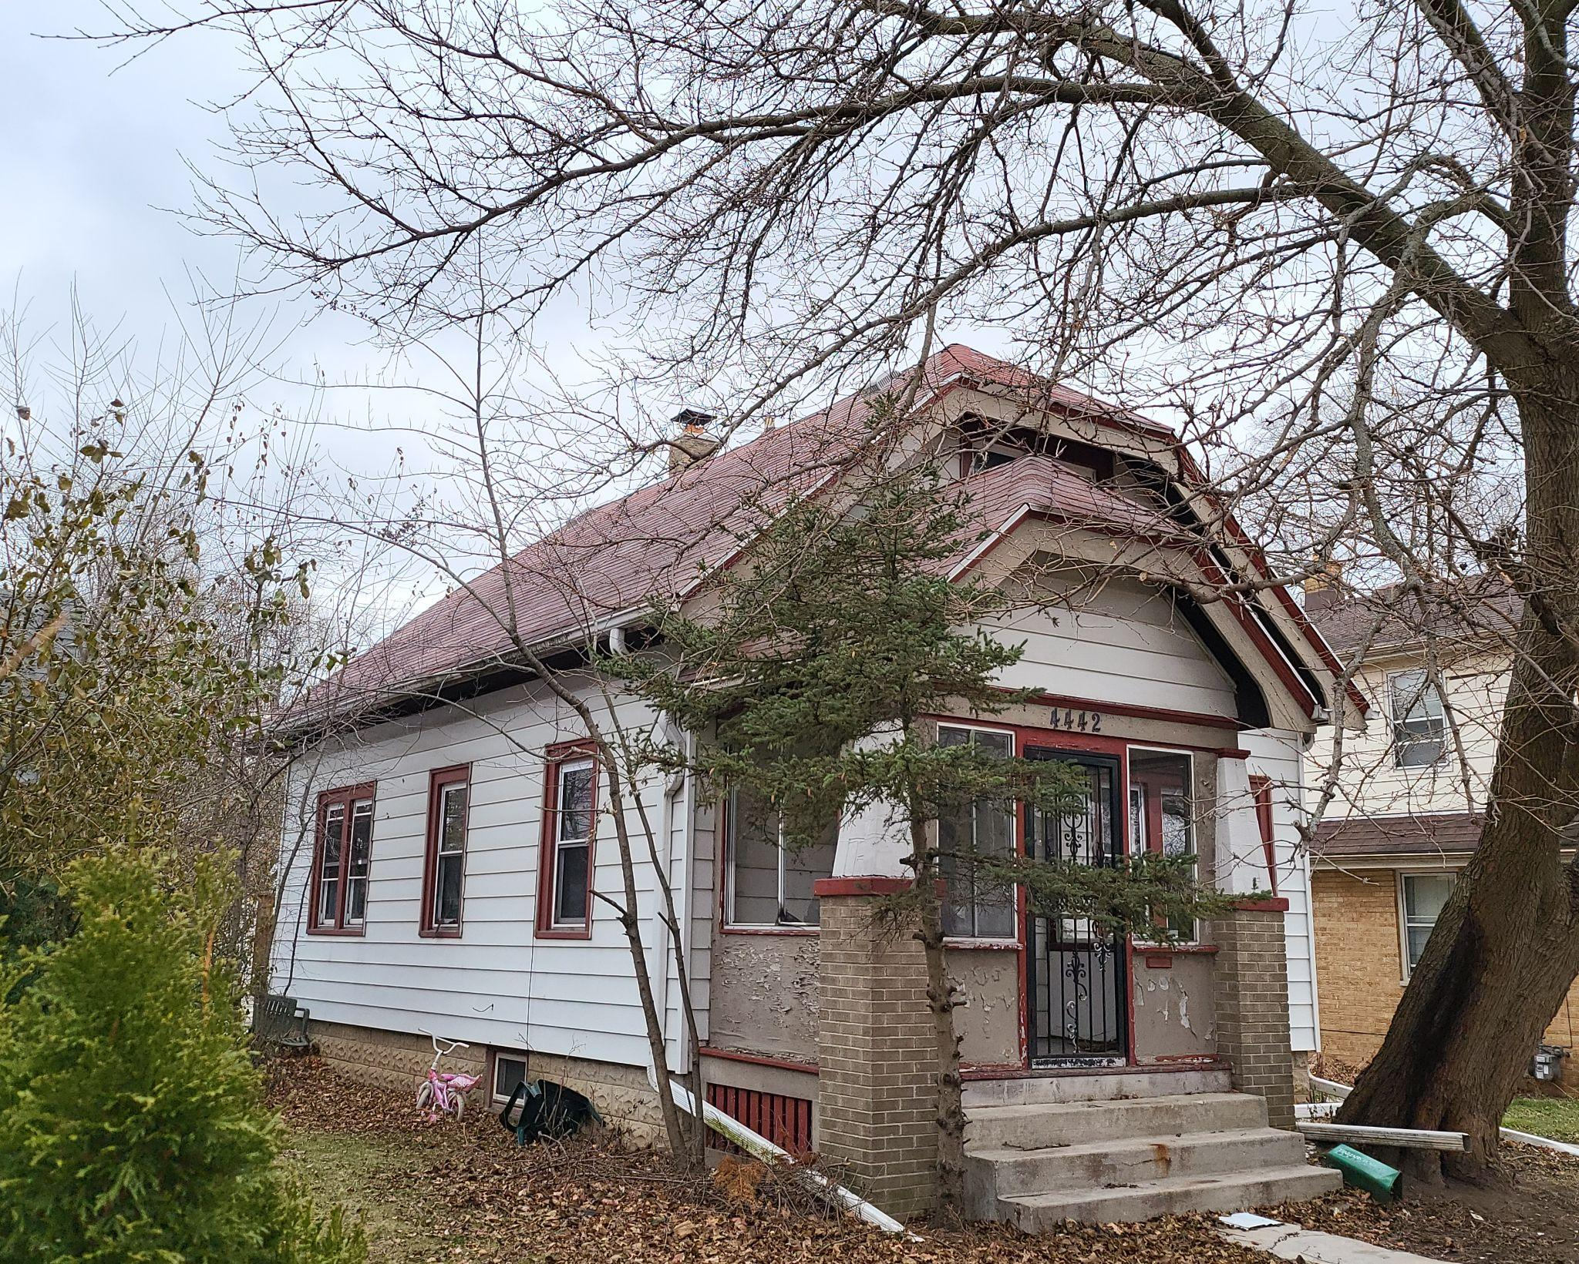
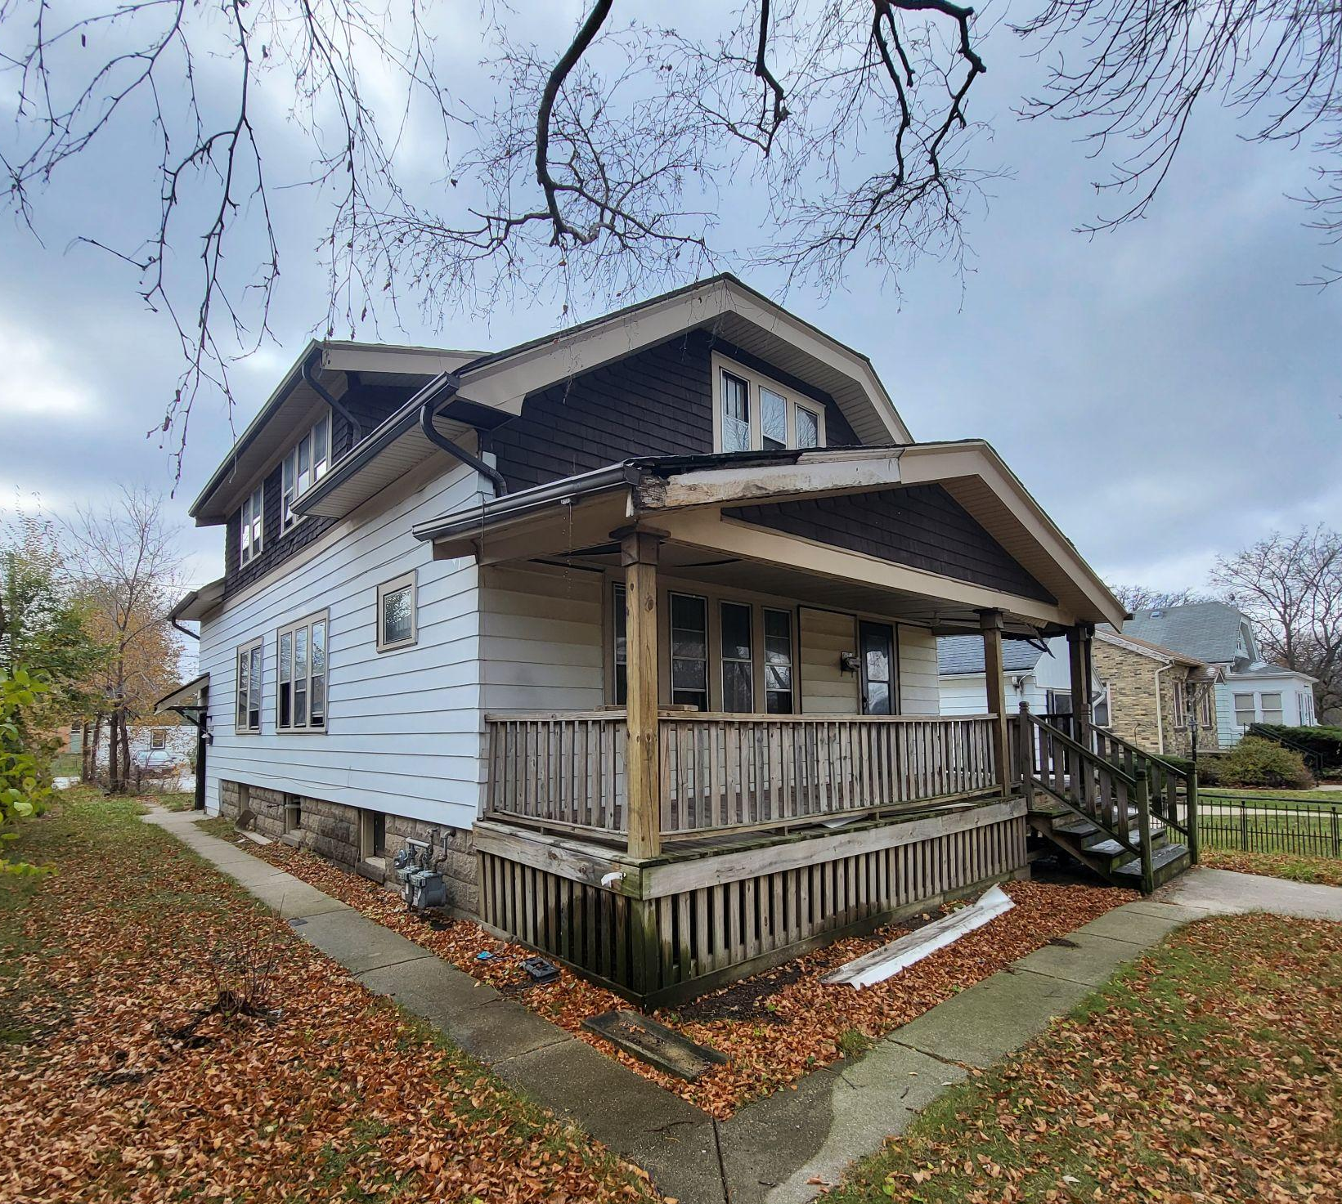
AQ FUND HOMES
Coming Soon - 4442 N 65
Notes:
Doc: Our next COMING SOON PROPERTY ON HIGHLAND AVE. 4 BED 1.5 BATH….

Slide 27
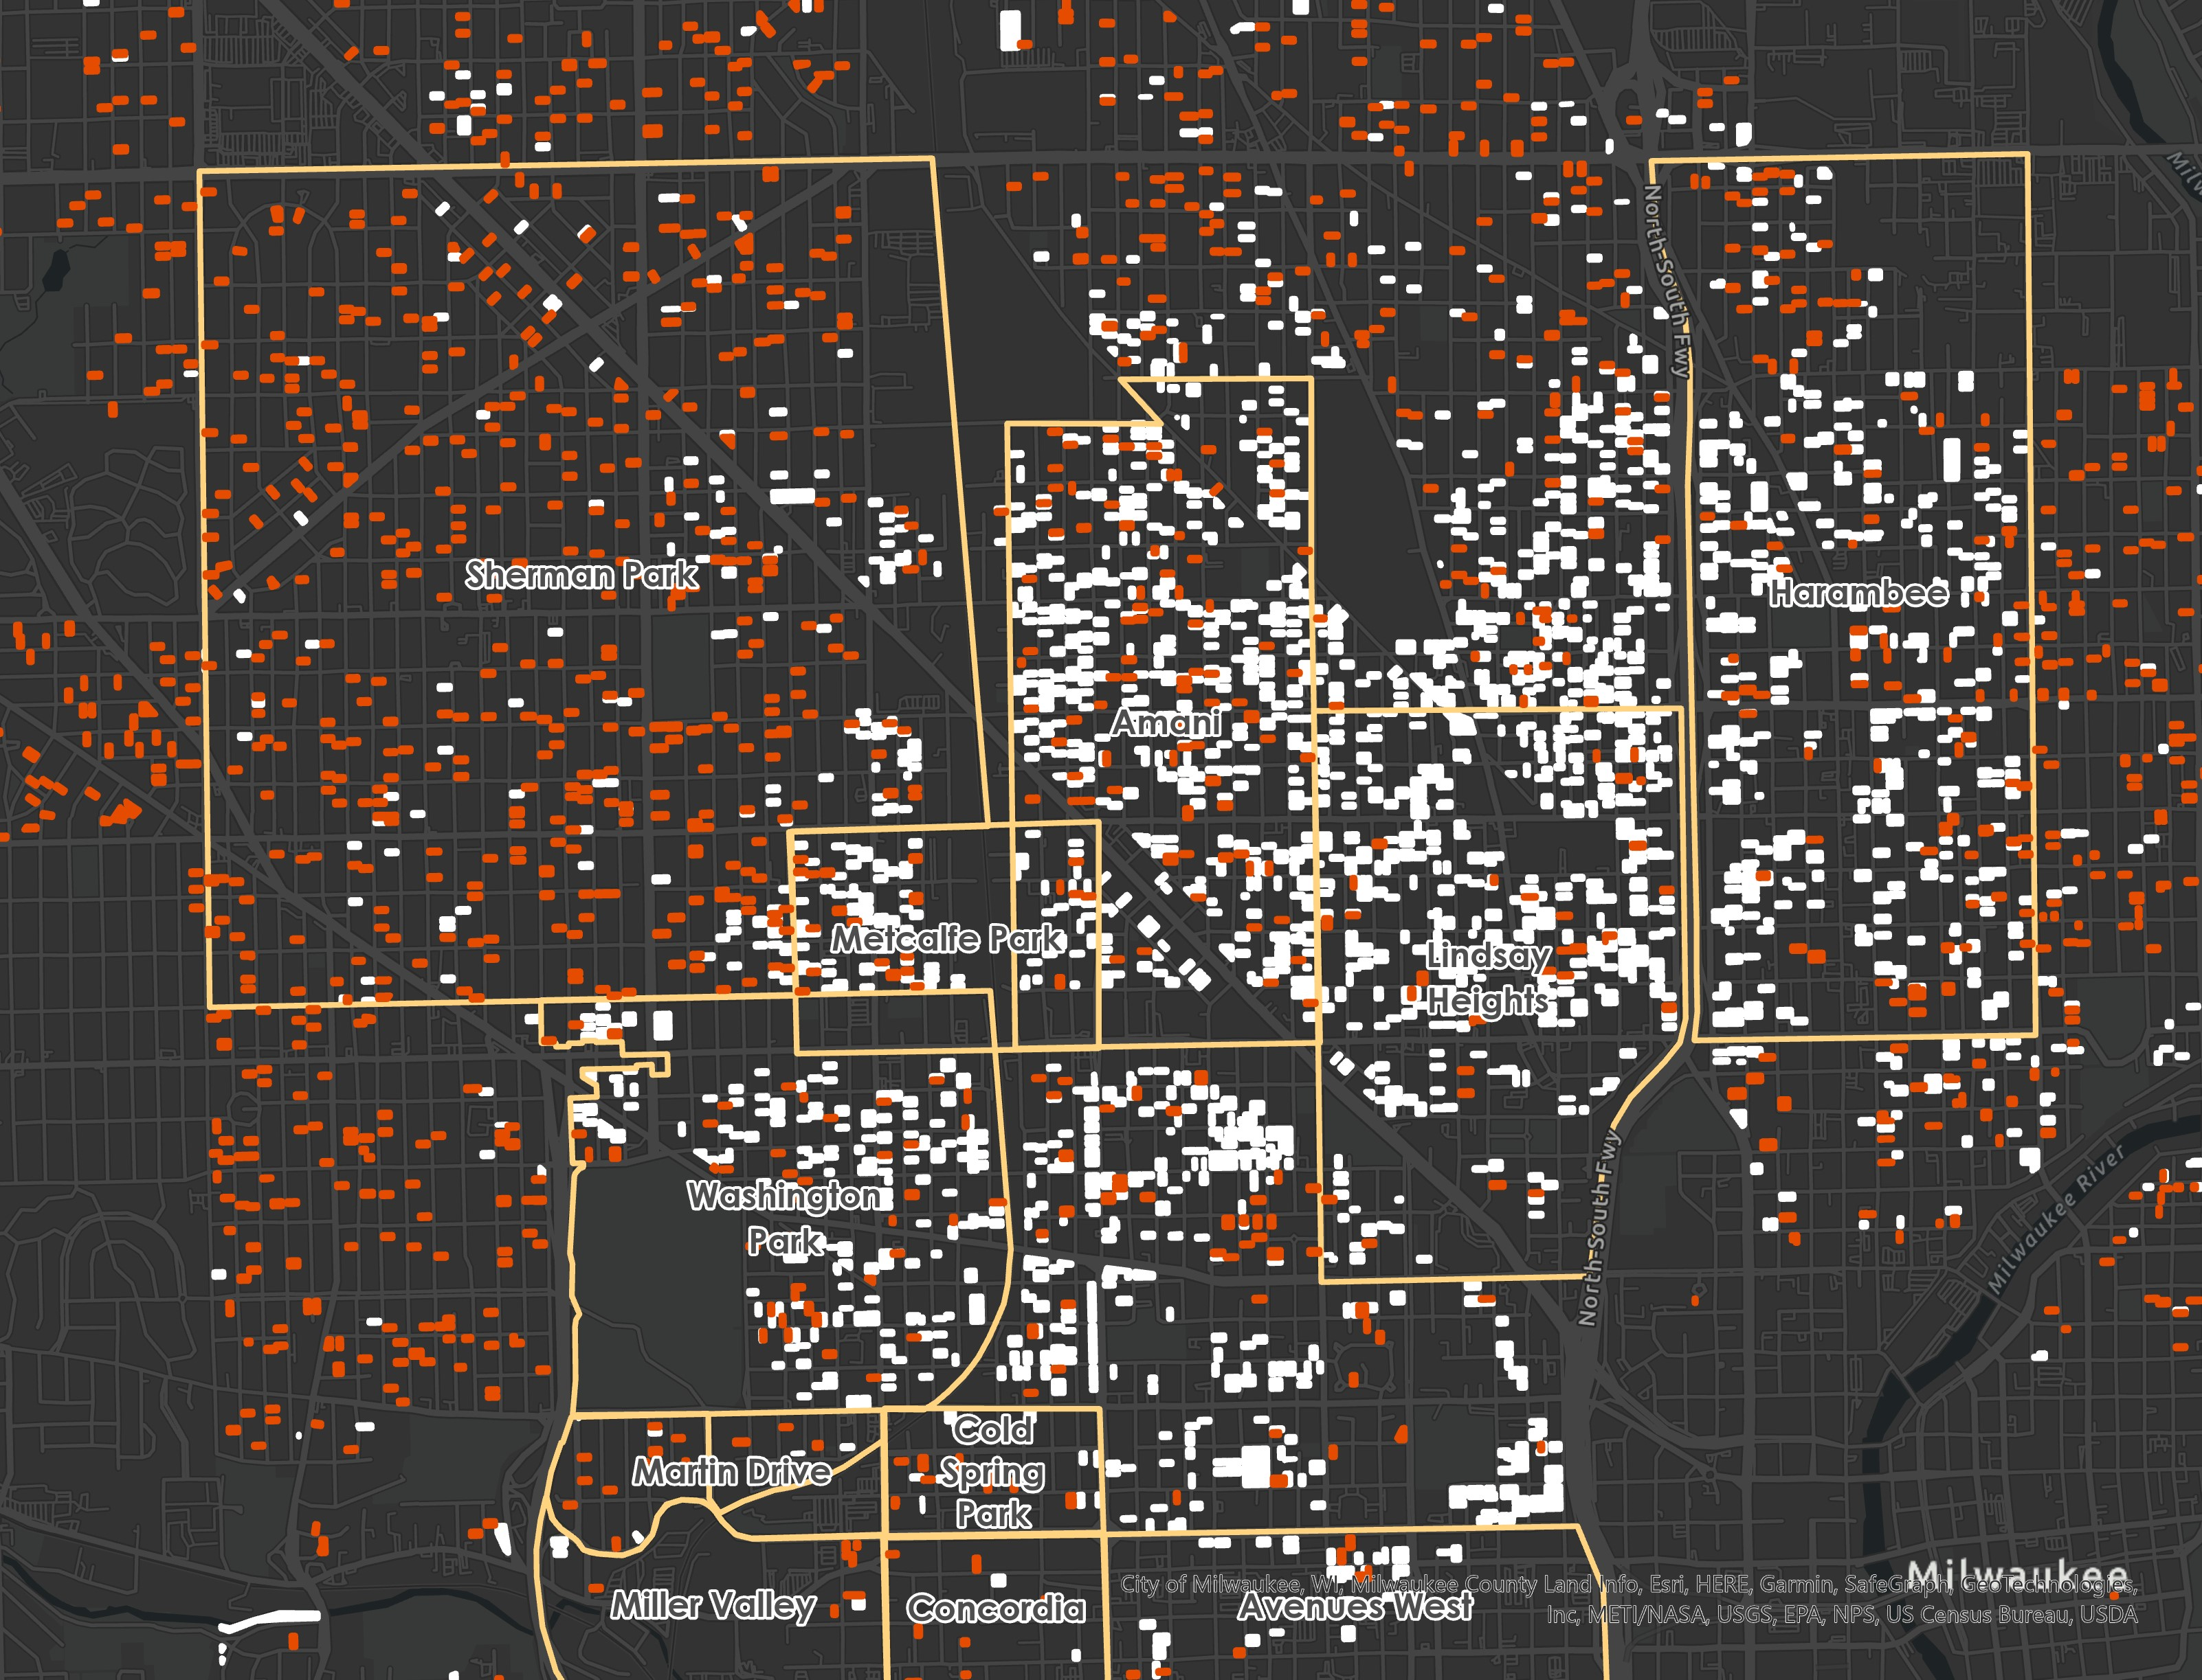
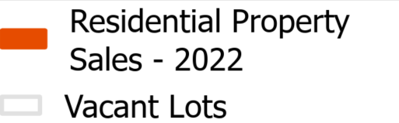
All 2022 residential property sales & vacant lots
Data Source: Home Mortgage Disclosure Act Data, 2022, Prepared and analyzed by Russell Star-Lack from Metropolitan Fair Housing Council, Map visualization by DYCU

Slide 28
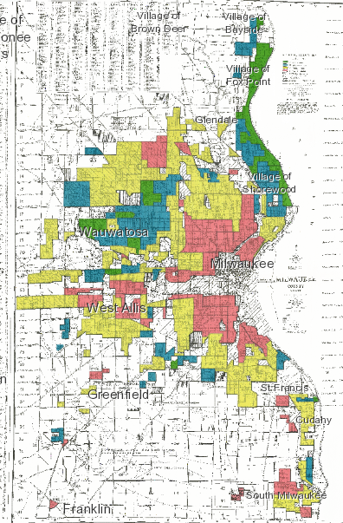
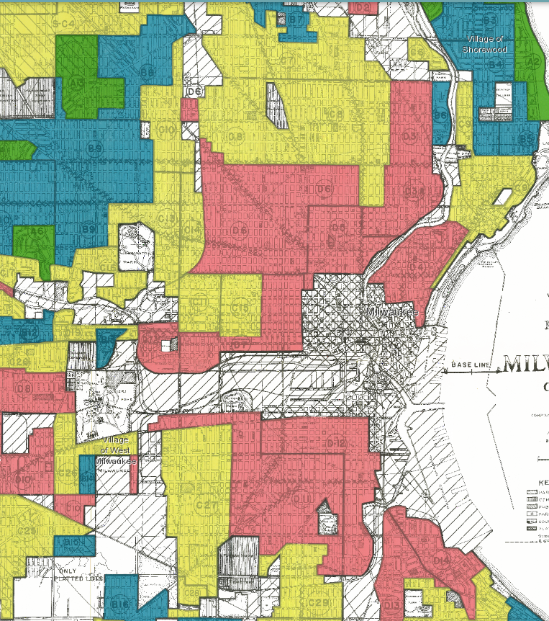






Slide 29
Need renewable non-competitive resources
Cost $250,000
Homebuyer $120,000
Philanthropy $30,000
TID $50,000
NMTC/lihtc/OTHER $50,000

Slide 30
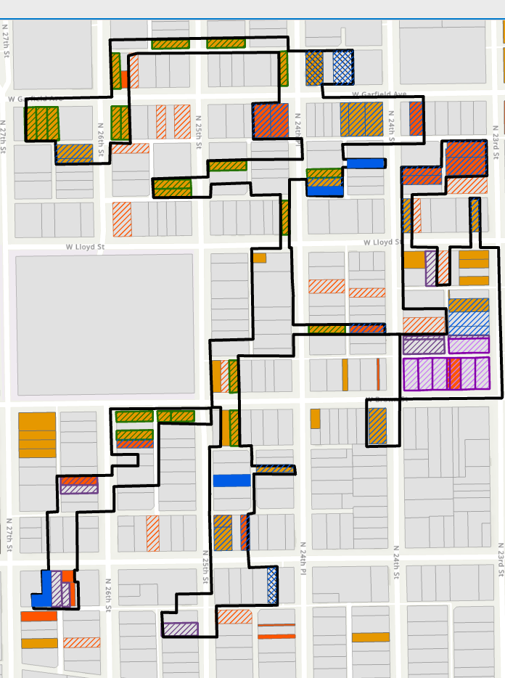
King Park Backbone TID
Increment Generated
Present Value 25 Year: $2.5 M
Project Support
Emem Duplexes: $1.6 M
Habitat Homes: $0.9 M
Potential MKE Homes* (4)
City Owned Vacant Lots
Privately Owned
Demolition List
2+ years tax delinquent
* Not included in TID Calculation
Emem Duplexes (40 homes)
Habitat Homes 2023 (7)
Habitat Homes 2024 (7)
Habitat Homes 2025 (16)
Habitat Homes 2026 (11)
Habitat Homes 2026* (10)

Slide 31
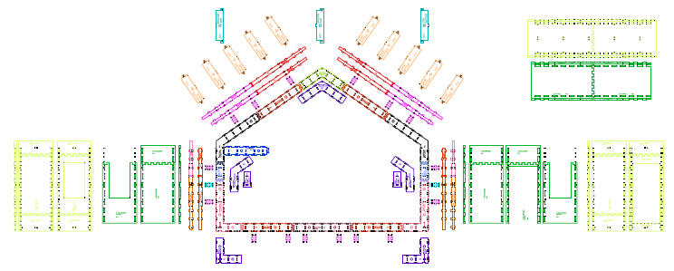
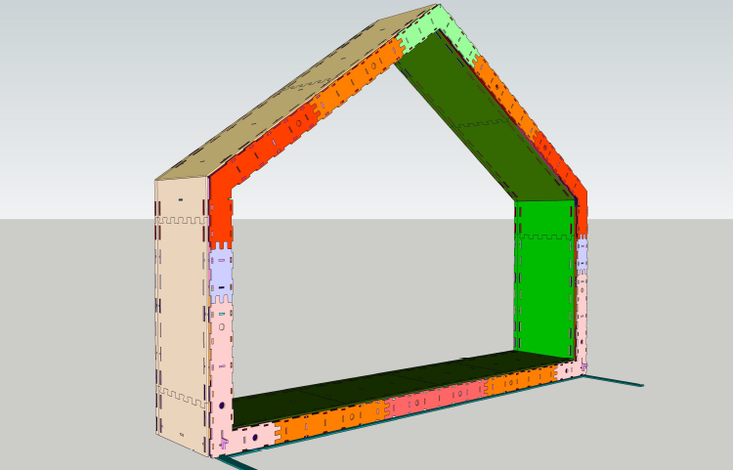
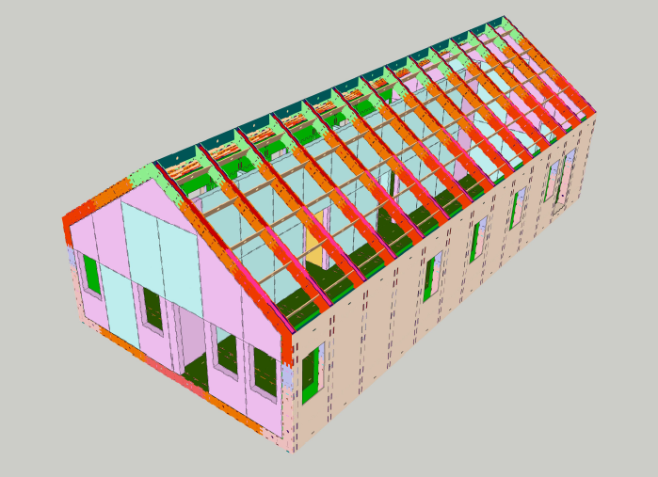

Slide 32
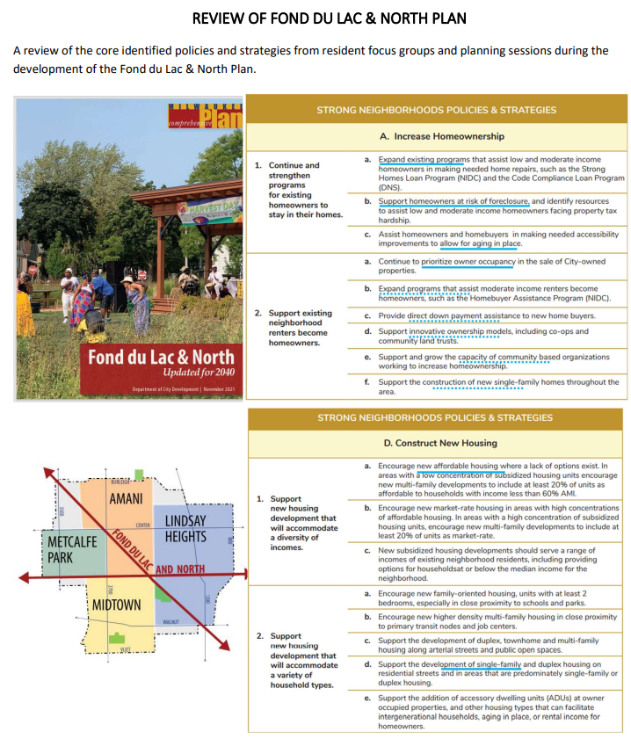
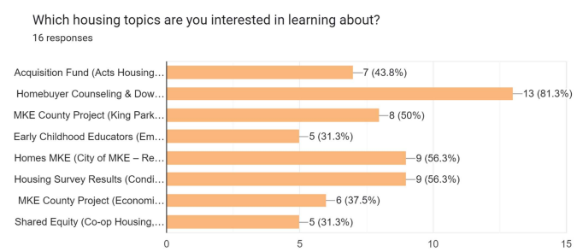
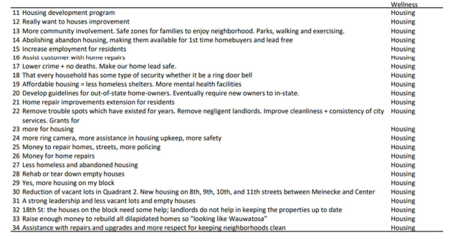
OUR COLLABRATION DESIGN

Slide 33



What can I do to help advance racial Equity through Housing
Plug in
Have an idea?
Get going
subscribe at www.housingplan.org
Email us at ideas@housingplan.org
Data and strategy support available
for additional information & updates visit www.housingPlan.org

Slide 34
Resident Council
Operational Funders
Council
Housing Investors Council
CDA
Governance
Neighbor-hood Groups
Advocacy Groups
Implement- ors

Slide 35


1
Systems Level
Investments that can impact housing policy or that can build new pathways to homeownership that don’t currently exist. These efforts cannot be done individually and require investments in a Collective Impact backbone organization.
4
Credit Level
Investments in providing credit available to families making the CMI or below. The primary reasons for denial are a Debt-to-Income ratio of 50% - 60% and non-housing related credit history. The market is not able to meet this demand, thus an investment is needed.
2
Implementation Level
Investments in entities that produce housing, or administer counseling, downpayment assistance, accessible loan products, or long-term support of homeowners. These entities are delivering a product that cannot be delivered by the market and thus require operational support.
5
Family Level
Investments that are given directly to homeowners in the form of down payment assistance, or the buy down of interest rates. These investments will directly reduce the costs of homeownership for families that receive the investment.
3
Inventory Level
Investments in the production of homeownership inventory that is available to families making the county median income (CMI) or below (e.g. $50,000) or less. The production of a home costs about $250,000 and the accessible sale price is $120,000, thus $130,000 of support is needed for each home.
Investments in Homeownership

